Slide 1
Flow Design Menus

Slide 2
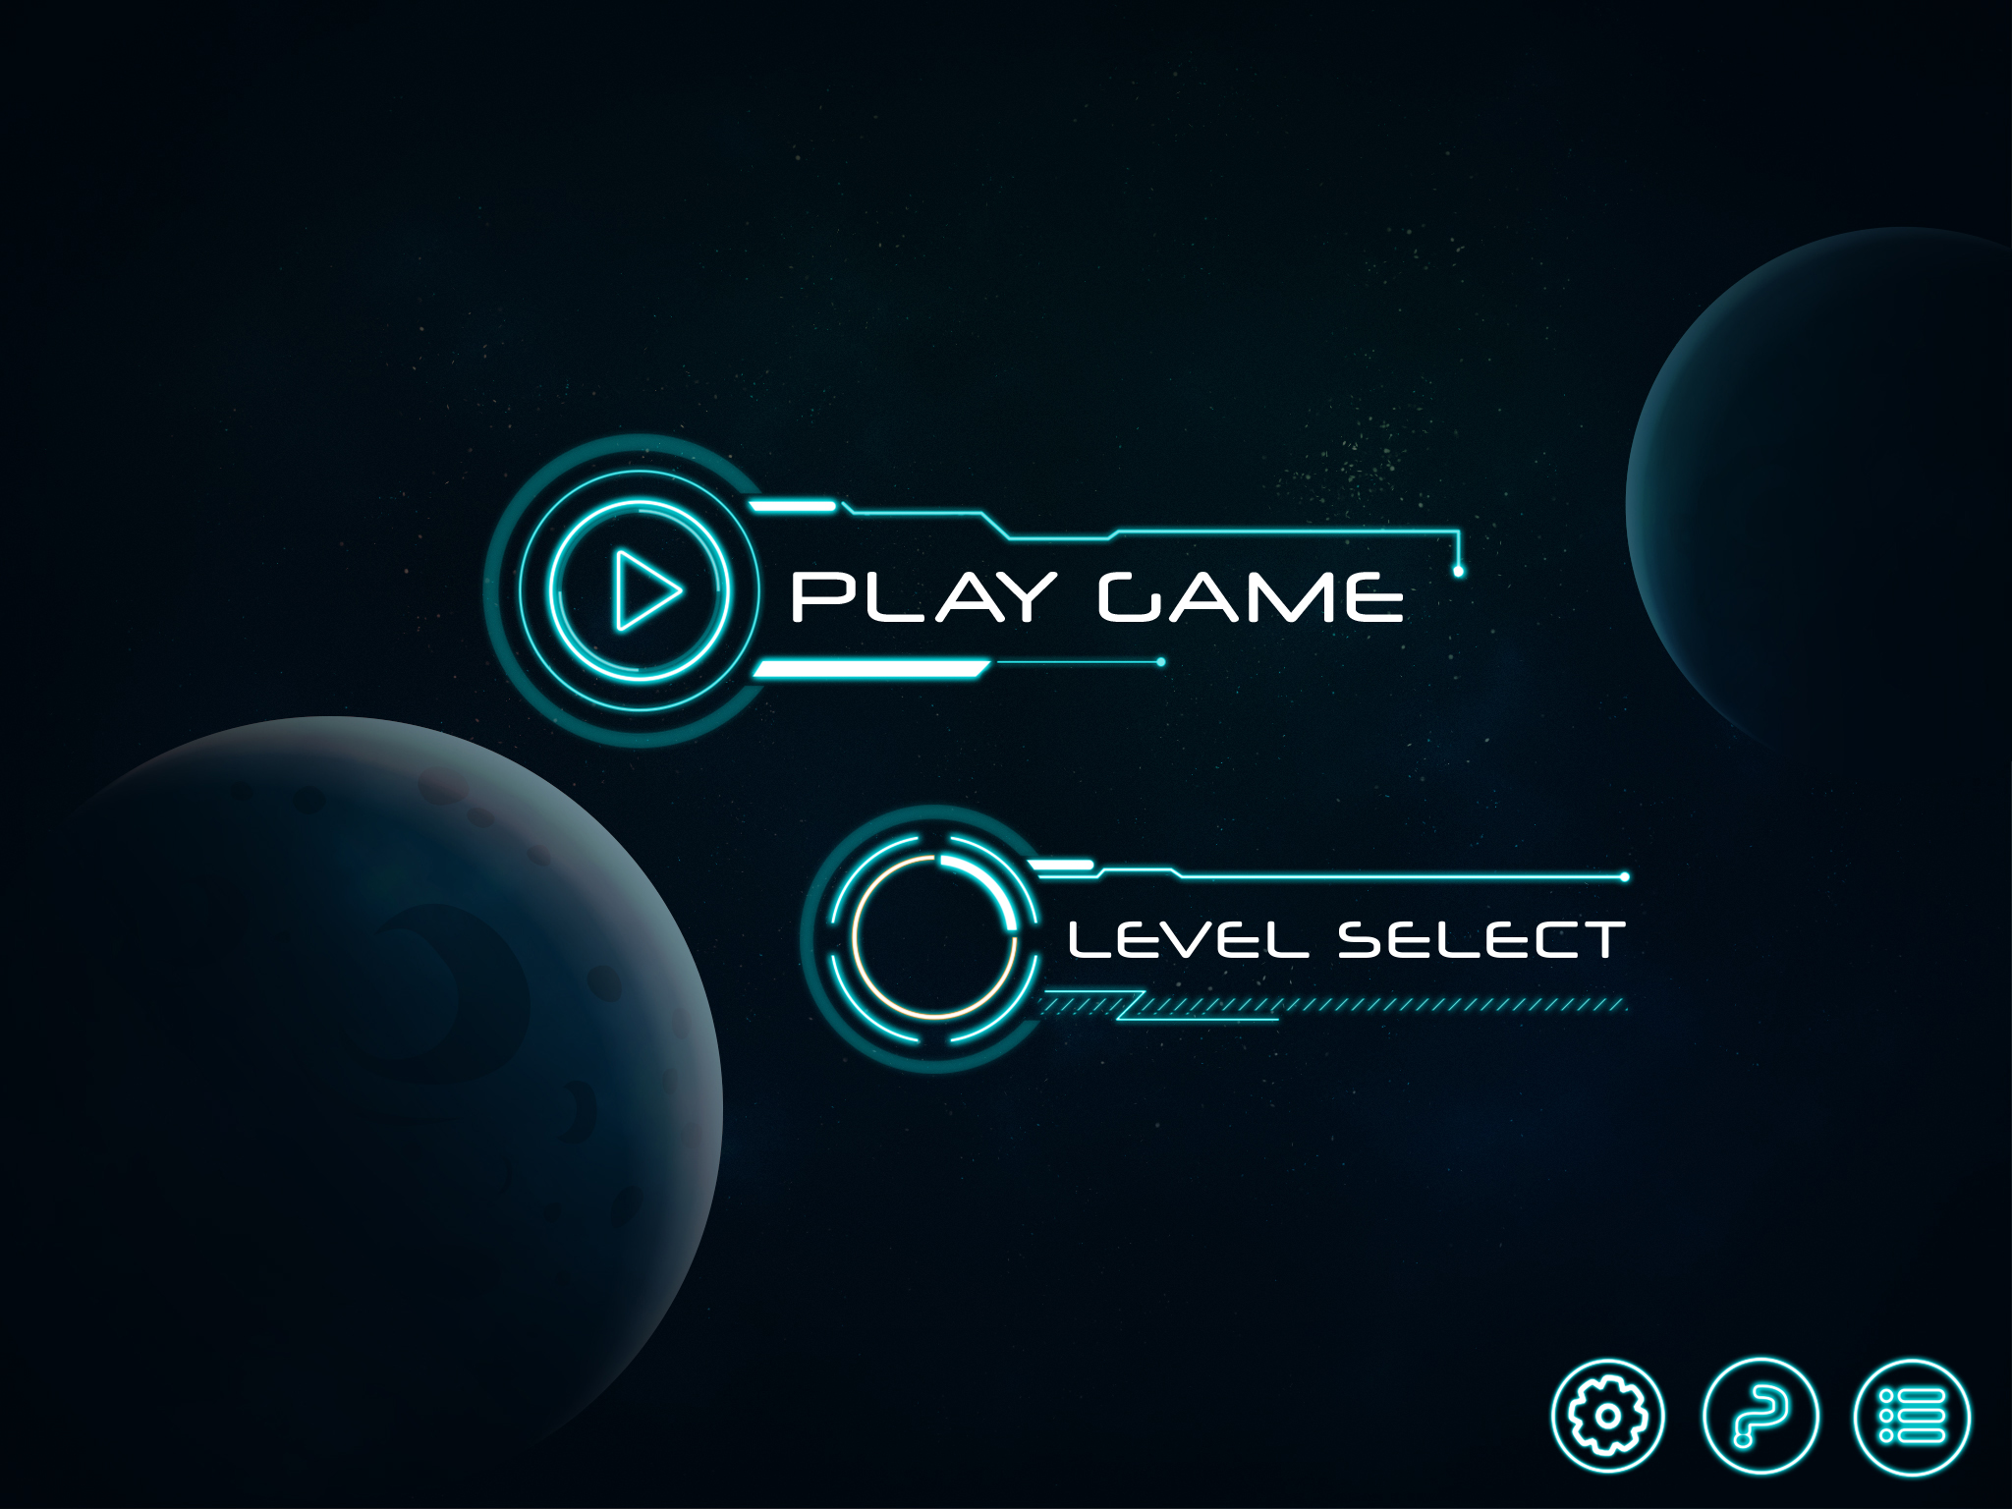
Start menu

Slide 3

Play Menu

Slide 4
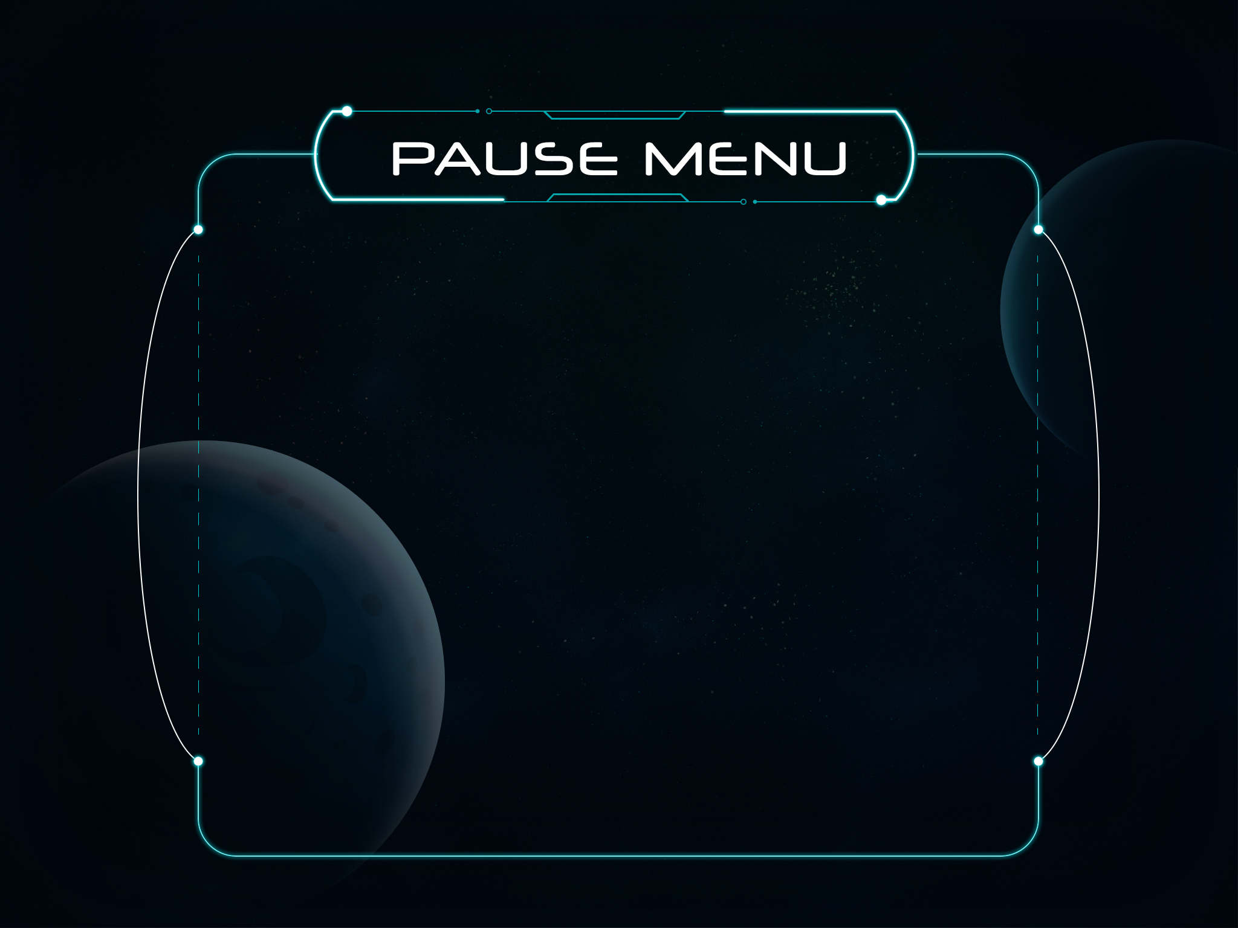
Pause Menu

Slide 5

Settings Menu

